Slide 1



ch
1.
A Project Report On
Submitted in partial fulfillment of the requirement for the award of the degree
Bachelor of Computer Application (BCA)
Academic Year 2023 – 24
(Aryan Ponkiya) 92200527253
(Divyesh Gangah) 92200527243
(Harsh Thobani) 92200527002
Internal Guide
(Prof. )
Rajkot-Morbi Road, At & PO : Gauridad, Rajkot 360 003. Gujarat. India.

Slide 2

Faculty of Computer Applications (FCA)
This is to certify that the project work entitled
Chatting App
submitted in partial fulfillment of the requirement for the award of the degree of
Bachelor of Computer Application
of the
Marwadi University
is a result of the bonafide work carried out by
Aryan Ponkiya(92200527253)
Divyesh Gangah(92200527243) Harsh Thobani(92200527002)
during the academic year 2023-24
Sunil Bajeja
Shridharan Sir
Faculty Guide |  | HOD |  | Dean

Slide 3
DECLARATION
We hereby declare that this project work entitled Chatting App
is a record done by me.
I also declare that the matter embodied in this project is genuine work done by me and has not been submitted whether to this University or to any other University / Institute for the fulfillment of the requirement of any course of study.
Place : Marwadi University – Rajkot Date : 10/4/2024
Signature : Aryan
Signature: Divyesh
Aryan Ponkiya (92200527253)
Divyesh Gangah (92200527243)
Harsh Thobani (92200527002)
Signature: Harsh

Slide 4
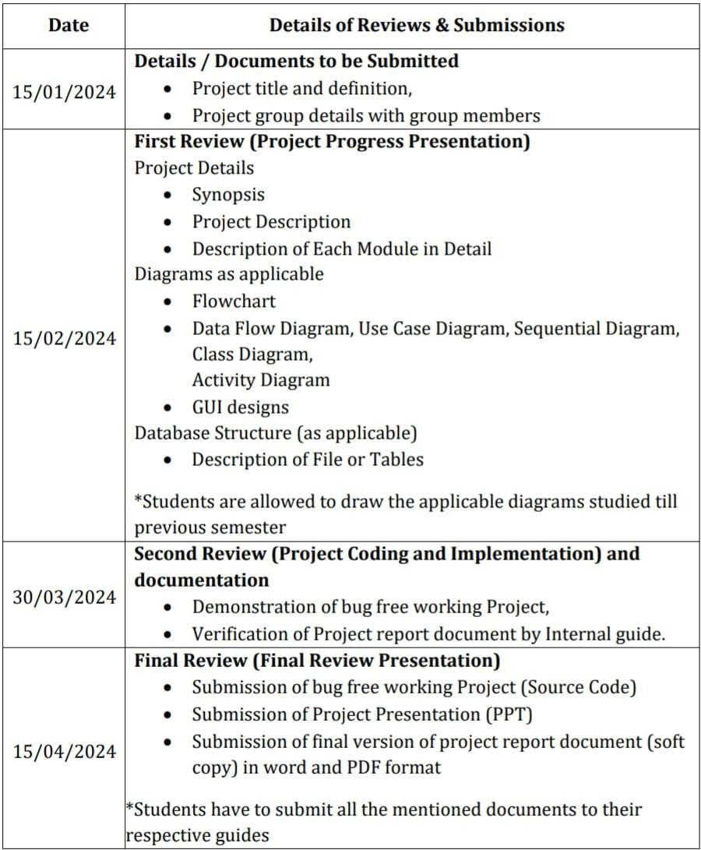
CONTENTS

Slide 5
1. PROJECT DETAILS
1.1 SYNOPSIS
A chatting app is a digital platform that allows users to communicate with each other in real-time through text messages. It typically features a user-friendly interface where individuals can send and receive messages instantly. Whether for personal or professional use, chatting apps make staying connected easy and convenient.
1.2 PROJECT DISCRIPTION
The chatting app is designed to communicate with each other. It is usually designed for private chatting with friends, family members and other people. It is use for fast communication and secured communication. The chatting app have simple inter face and simple build.

Slide 6
1.3 ALGORITHM AND FLOWCHART
Algorithm
Step 1: Start.
↓
Step 2: Enter the message whatever you like to send to other person
↓
Step 3: Send the message you write.
↓
Step 4:Read the message that sender send you.
↓
Step 5: End

Slide 7
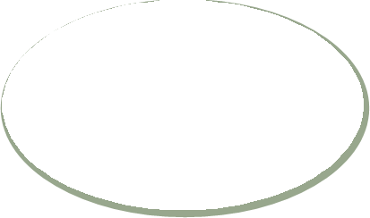











FLOWCHART
Start
Write the message
Send message to the reciever
Read the message that sender send you
End

Slide 8



DATAFLOW DIAGRAM
User Name
Add people
User ID
Chatting System
Login
Add message
User Account

Slide 9








USECASE DIAGRAM
User name
Add User
Add User
User account
Login
User ID

Slide 10
SEQUENTIAL DIAGRAM
User
System Manager
Admin
Send message
Send message
Creat
e Acc
ount
Log In
communicate
Request to modify/remove account
Forward Request
Update/Delet
e Accoun

Slide 11
ACTIVITY DIAGRAM
EMPLOYEE
Login
Verify
Account
Send Request
Reports
Change Password
Send Message
Sender
Recieve
Send

Slide 12
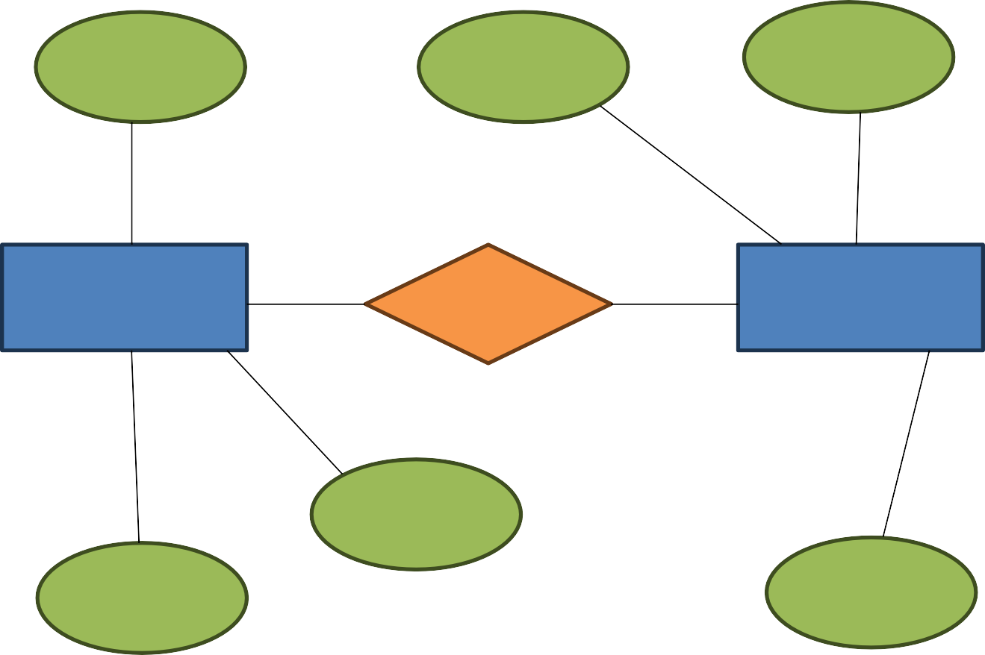
Entity Relationship Diagram
Email
ID
Username
User
Has
Login
Name
Phone
Password

Slide 13
LEARNING DURING PROJECT
Choose a simple project
  Select a small project idea is that aligns with your current level of Python language knowledge. Example could include Chatting App.
Study Relevant Concepts
  As you encounter new concepts and functions, refer to Python language documentation, textbooks, or online tutorials to understand them batter. Topics like variables, loops and functions are essential.
Write code incrementally
  Start with the basics and build your project incrementally. Test each part as you go to ensure it works before moving on to the next.
Debugging
  Debugging is important part of the learning process. When you encounter errors, use debugging tools and print statements to identify and fix them.
Share and Discuss
  Share your project with others, whether it’s friends, mentors, or online communities. Discussing your code can lead to valuable insights and suggestions for improvement.

Slide 14
BIBLIOGRAPHY
Online Refrances
  “Pythontutorial” → W3Schools
  YouTube → ‘Codewithherry’

Slide 15
THANK YOU
(Specially, To our project Guide)

